Slide 1
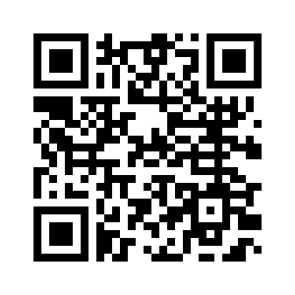
COMPUTER SCIENCE CLUB
Intro To Python
Maitreyee and Joshua

Slide 2
CS Club
Introduction

Slide 3

Introduction
A programming language is a set of grammatical rules to instruct the computer to achieve a task
Python is an example of a programming language
They are often used to manipulate data
Data can be of different forms
These different forms are called data types

Slide 4
CS Club
Data Types

Slide 5
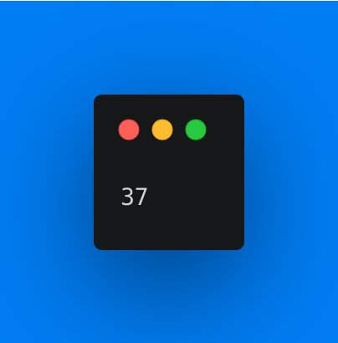
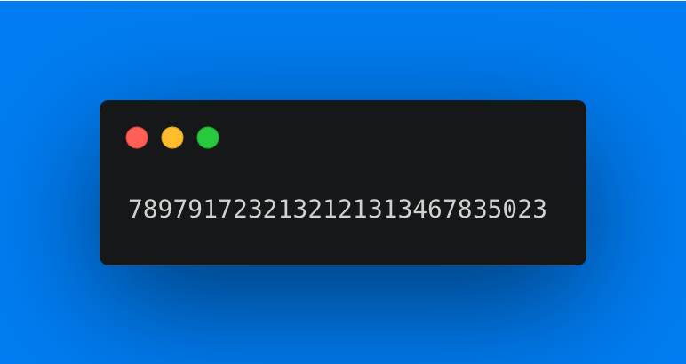
Data types
int: stands for integer, refers to any whole positive or negative number WITHOUT a decimal

Slide 6
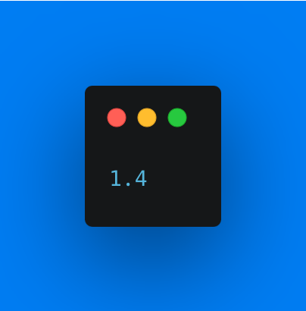

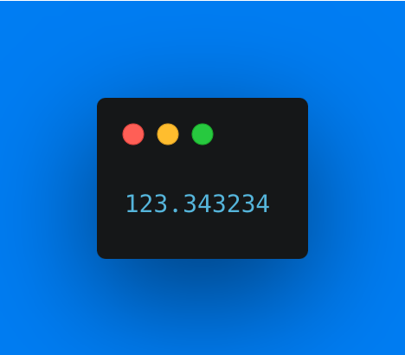
Data types
float: stands for floating point number, refers to a positive or negative number with a decimal point

Slide 7
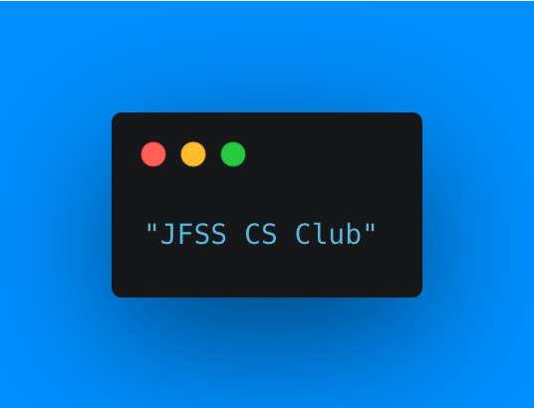
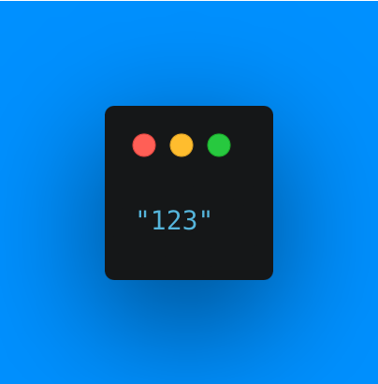

Data types
str: this stands for string, refers to anything enclosed within “”

Slide 8

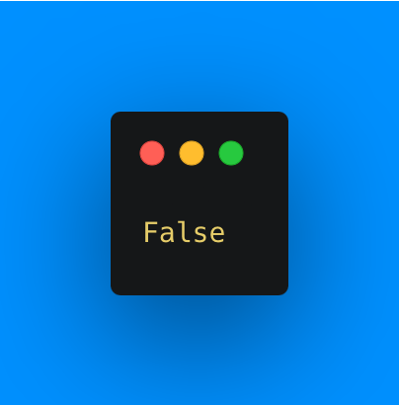
Data types
bool: this stands for boolean, can hold two values either true or false

Slide 9
Arithmetic Operators
For int and float data types in Python, we can carry out arithmetic operations, just like you would do in math
Operators include
Addition: Adds the numbers, denoted by +
Subtraction: Subtracts the numbers, denoted by -
Multiplication: Multiplies the numbers, denoted by *
Division: Divides the numbers, denoted by /
Modulo: Gives the remainder when the first number is divided by the second, denoted by %

Slide 10
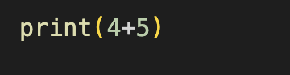
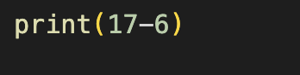
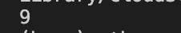
Arithmetic Operators
Addition
Subtraction

Slide 11
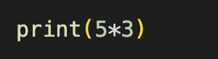
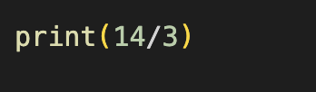

Arithmetic Operators
Multiplication
Division

Slide 12
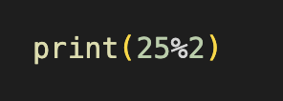
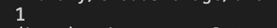
Arithmetic Operators
Modulo

Slide 13
CS Club
Variables

Slide 14


Variables
Amazing!

Slide 15
Variables
Data
Notes:
You can think of variables as just empty boxes that store data

Slide 16
Variables
Variables are things that can store any value assigned to them
The process of assigning a variable a value is called variable declaration
Syntax of a python variable:
Name of the variable followed by
An equal sign =
And then the value that the variable is meant to hold
Note: remember this would be either one of the data types mentioned above

Slide 17
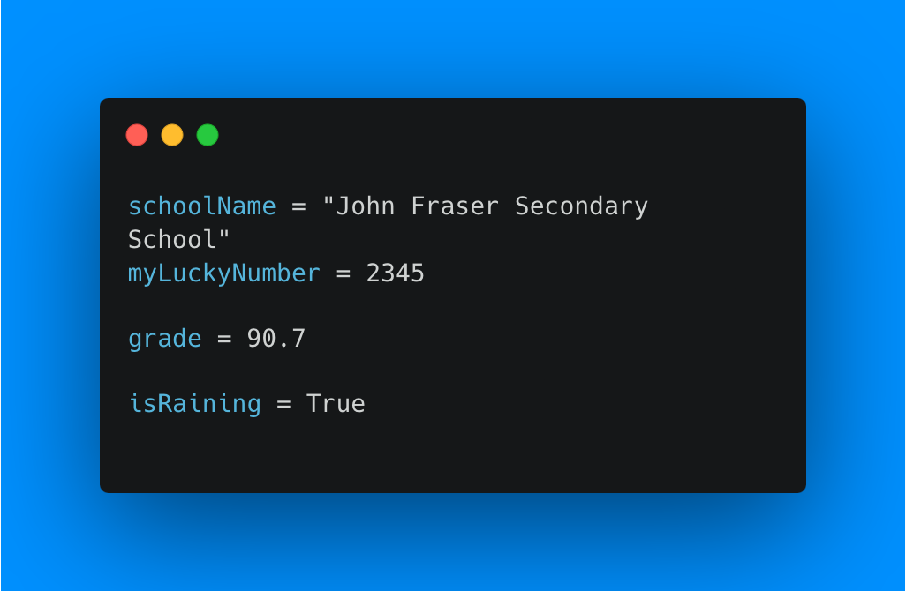
Variables

Slide 18
CS Club
Conditional Statements

Slide 19
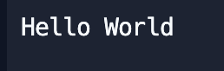
But First…
Printing text into console
Output:
Comments

Slide 20
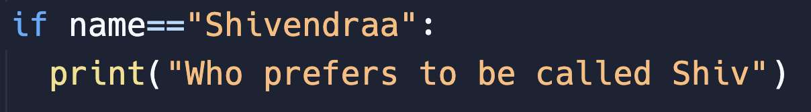
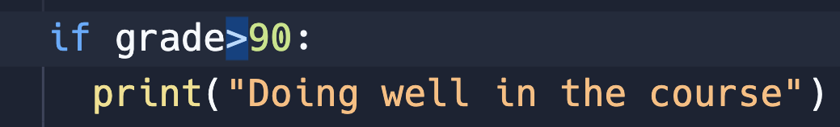
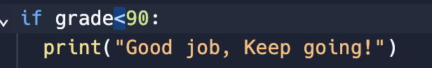
If Statements
== when comparing
: after condition
> more than
< less than

Slide 21
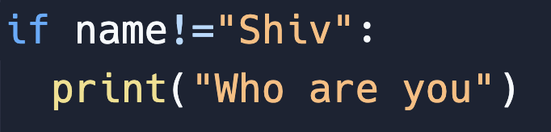

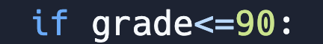
Other Comparison Operators
!= means not equal to
More than or equal to
Less than or equal to

Slide 22
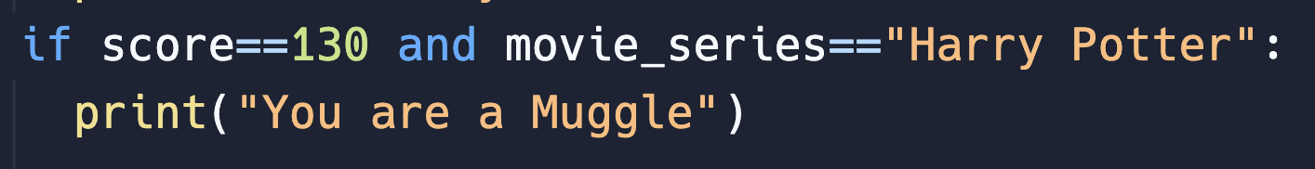
Combining conditions (and, or)
and: Both conditions have to be true for code to run
or: if any condition is true, or if both are true, then run the code.

Slide 23
CS Club
If, elif and else
Bank ATM Program

Slide 24
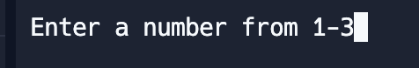
Accepting User Input
User input is stored in the choice variable
User input is always given as a string

Slide 25
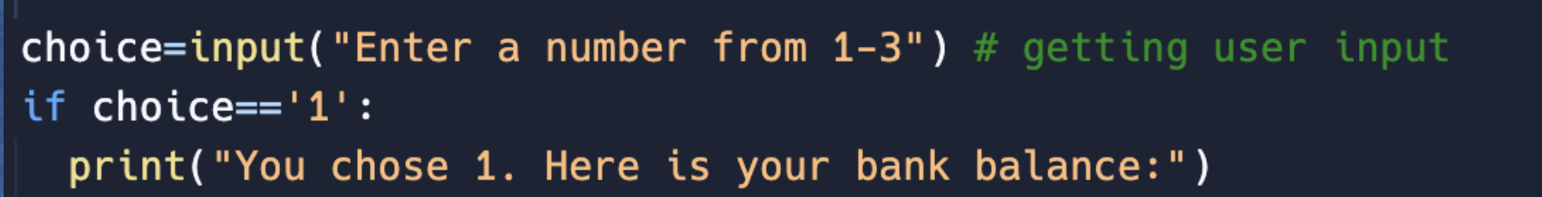
Handling User Input-Choice 1
Gets user input
If user input is 1, give them their bank balance
Why do we have to put ‘1’ in quotes?

Slide 26
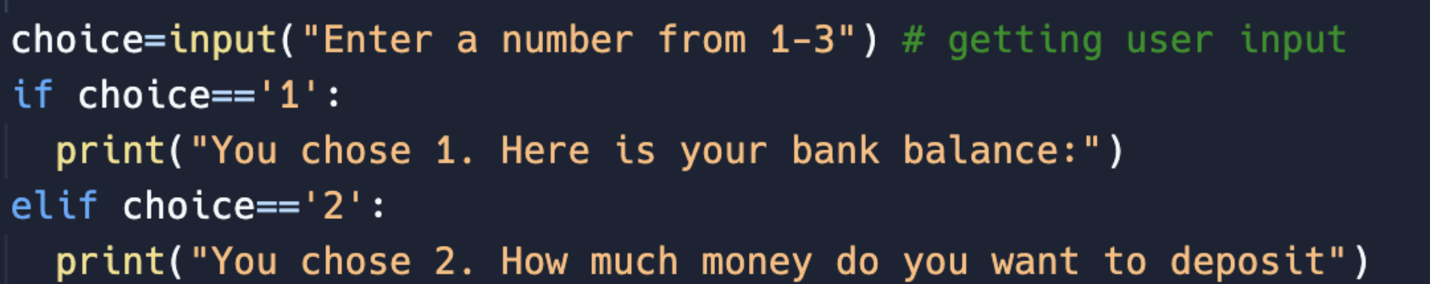
Handling User Input-Choice 2
Gets user input
If user input is 1, give them their bank balance
If not, then check if user input is 2

Slide 27
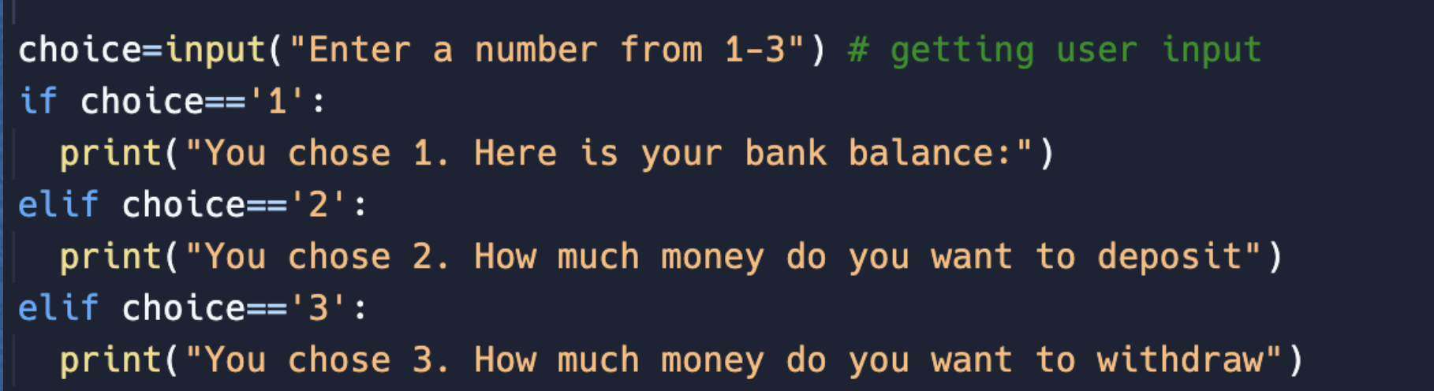
Handling User Input-Choice 3
Gets user input
If user input is 1, give them their bank balance
If not, then check if user input is 2
If not, then check if user input is 3

Slide 28
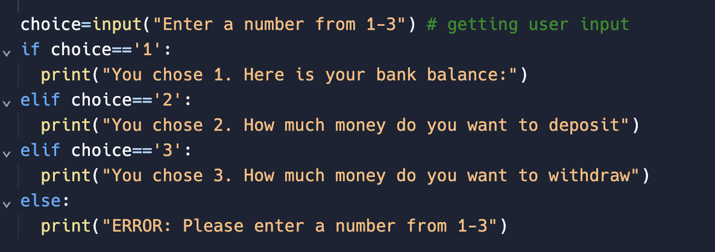
Handling Invalid Inputs
Gets user input
If user input is 1, give them their bank balance
Otherwise check if user input is 2
Otherwise check if user input is 3
Else: if none of the above are true, print error

Slide 29
CS Club
Activity Time

Slide 30
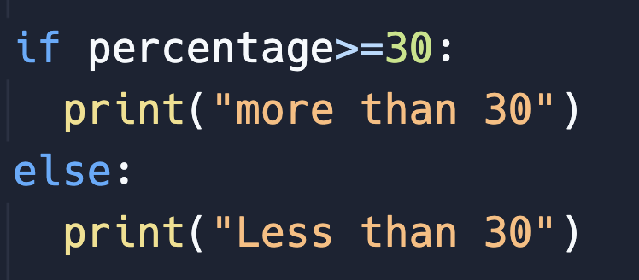
Make Your Own If statement
Beginner
If grade is more than or equal to 50, print pass, else print fail
Example Syntax:
Experienced
If grade is from 85 to 95 set grade to 100, else +5 to the grade.
If after adding 5, grade is more than 100, print(“bonus”)

Slide 31
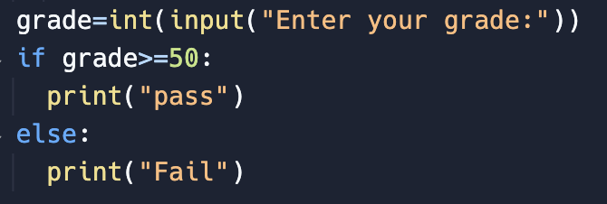
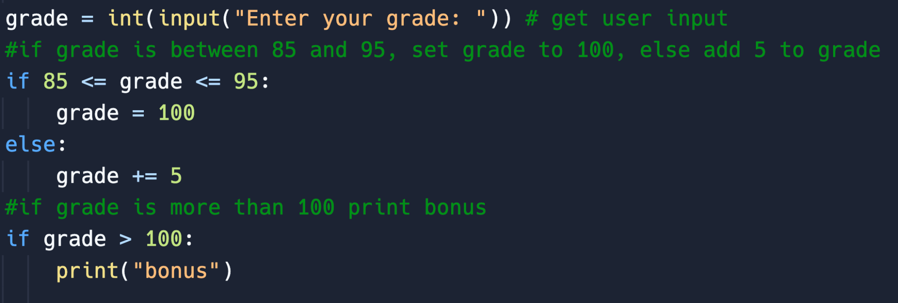
Solutions
Beginner
If grade is more than or equal to 50, print pass, else print fail
Experienced
If grade is from 85 to 95 set grade to 100, else +5 to the grade.
If after adding 5, grade is more than 100, print(“bonus”)

Slide 32
CS Club
For Loops

Slide 33
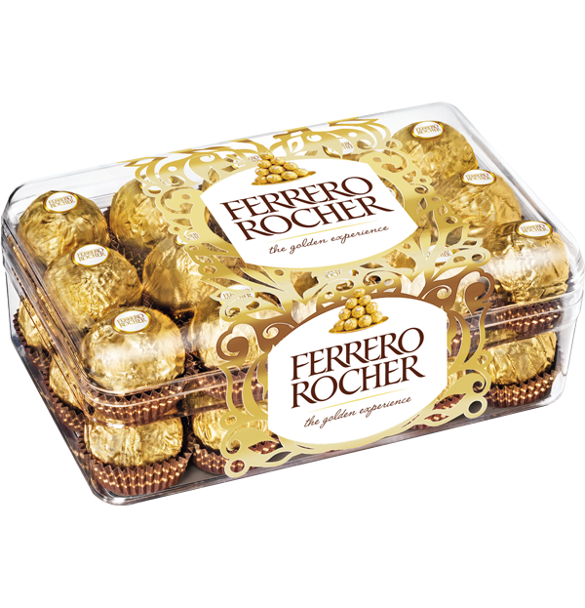
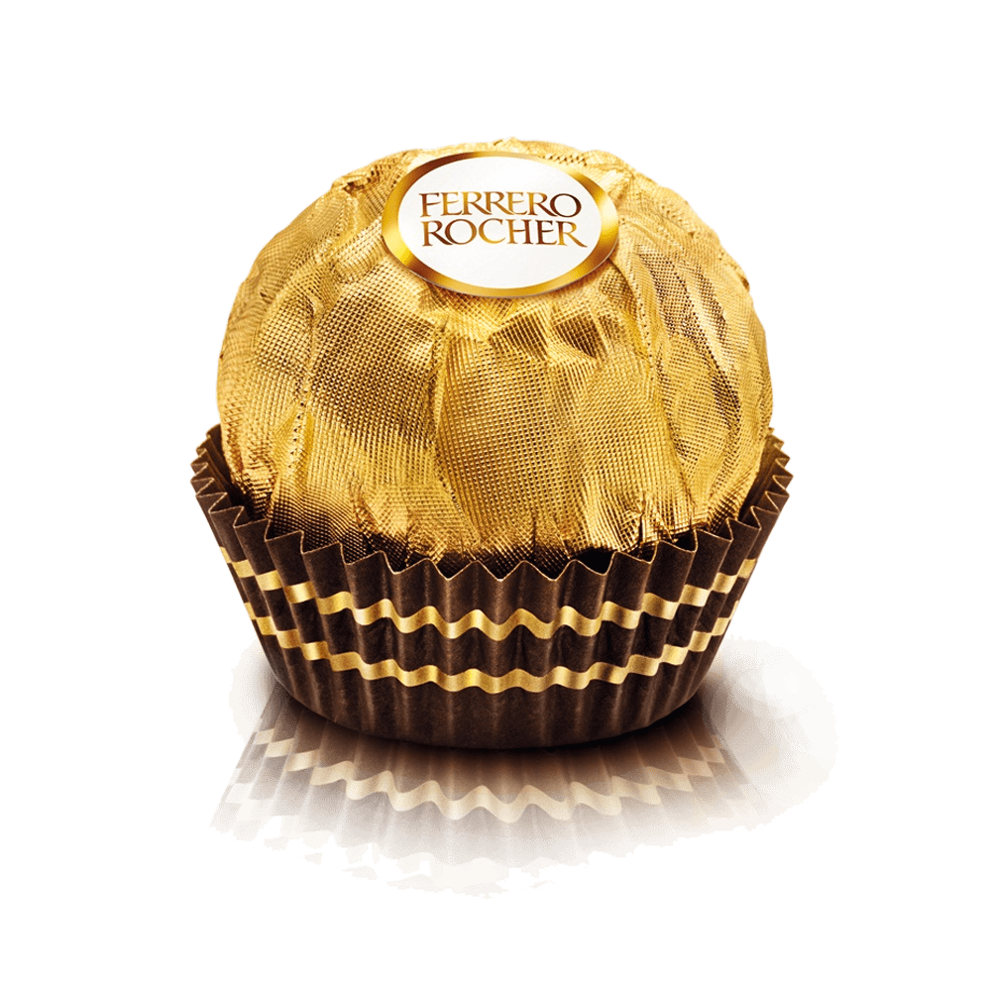
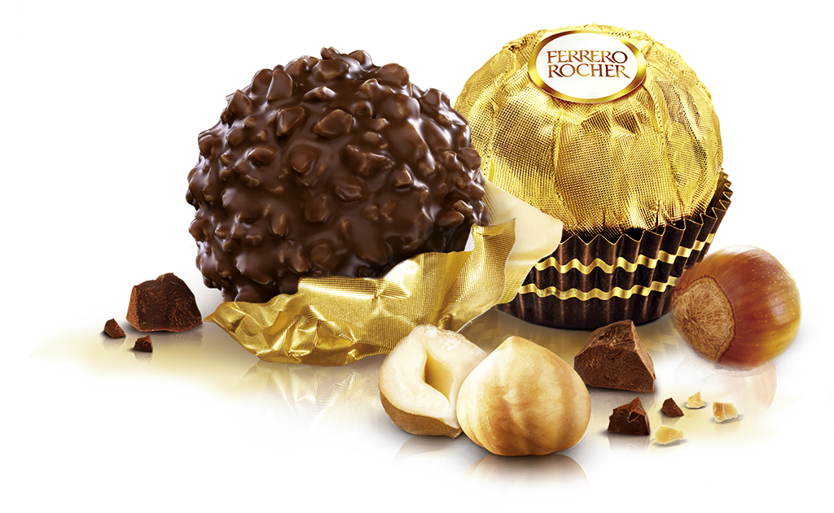
For loops

Slide 34
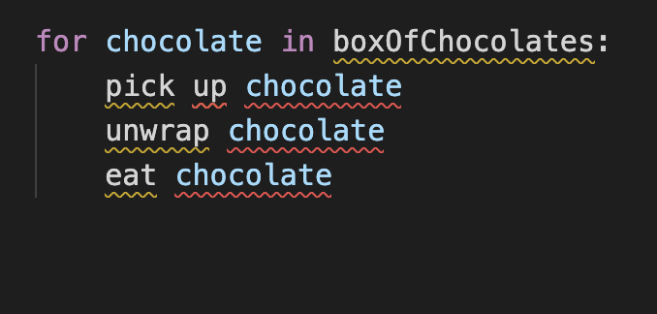
For loops

Slide 35
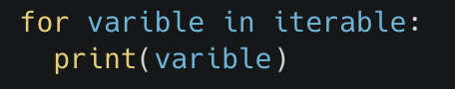

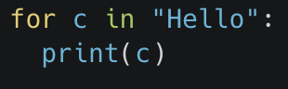
For Loops
Basic Syntax
Looping through a string:
Output:

Slide 36
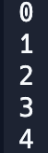
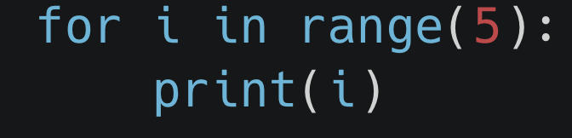
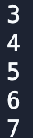
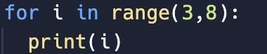
For Loops
Looping Through a Range:
Loop from 0 to 4
Range includes first_num -> last_num-1
Never includes last number
Loop from 3 to 7

Slide 37
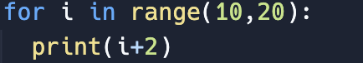
What will happen?

Slide 38
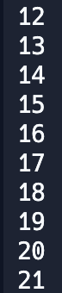
Solution: What will happen?

Slide 39
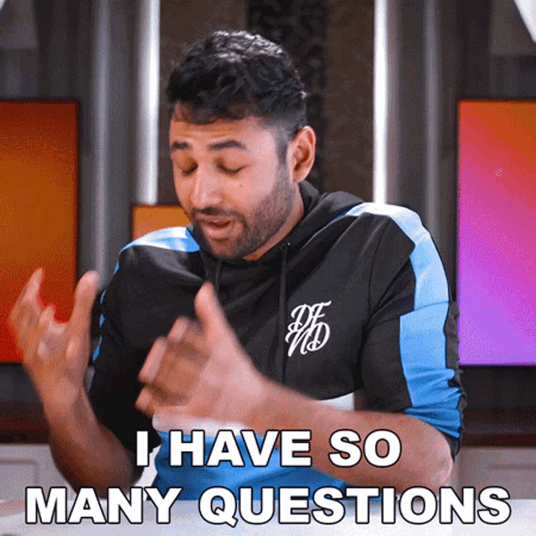
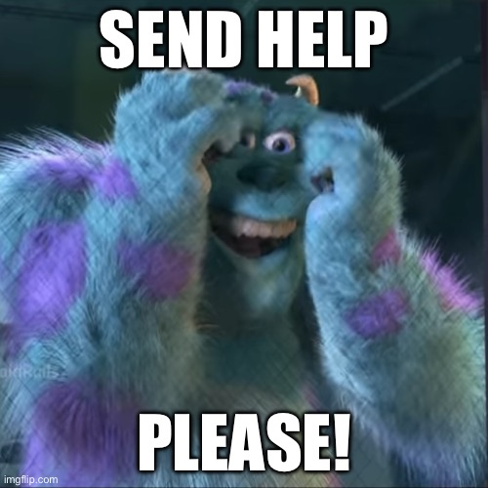

Slide 40
Lesson Challenge
Start with: fahrenheit = int(input("Enter the temperature in fahrenheit"))
Convert next 5°F to °C. So if °F=32, convert 32,33,34,35,36F to °C.
Use: (fahrenheit - 32) * 5/9
For each degrees:
Display each conversion
If celsius is from 25 to 35, print summer
If celsius is from 14-24, print fall
If celsius is from 3-13 print, spring
If celsius is from -30 to 2 print winter
Else print anything

Slide 41
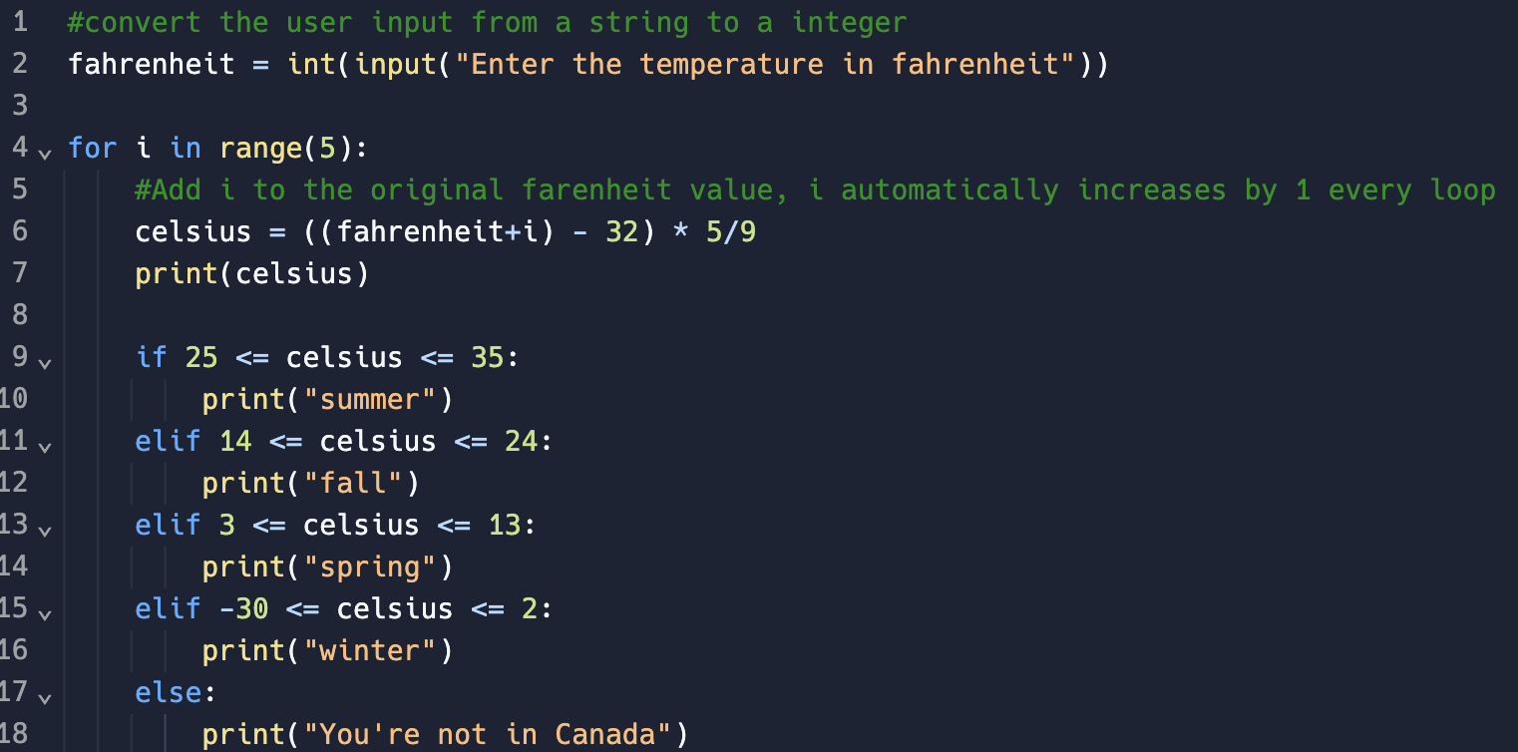
Challenge Solution

Slide 42
THANK YOU!

